Slide 1
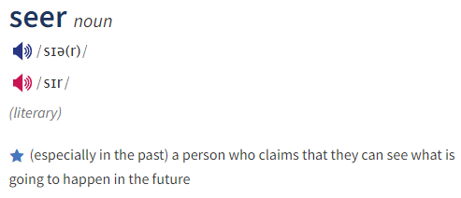
SEERA
A Python-based Framework for Future Community Prediction

Slide 2


PRELIMINARIES

Slide 3




Overview
60 days ago
59 days ago
58 days ago
…
Yesterday
Today
SEERA
Why? Who?
Tomorrow

Slide 4

Pipeline
SEERA
TWEETS
U1
U1
User | T1 | T2 | T3
U1 | 0.8 | 0.2
U2 | 1
U3 |  | 0.5 | 0.5
U4 |  | 0.8 | 0.2
Topic Modeling
T1:
T2:
U2
User Modeling
U2
U3
T3:
U3
U4
U4
U3
U4
User | D1 | D2 | D3 | D4
U1 | 0.4 | 0.1 | 0.6 | 0.8
U2 | 0.1 | 0.6 | 0.8 | 0.1
U3 | 0.9 | 0.5 | 0.5 | 0.1
U4 | 0.8 | 0.8 | 0.2 | 0.3
Community Prediction
Graph Embedding
U1
U2

Slide 5


Data
RAW TWEETS
TAGME ANNOTATED TWEETS
TAGME
Pooling
5

Slide 6
Pipeline
SEERA
TWEETS
U1
U1
User | T1 | T2 | T3
U1 | 0.8 | 0.2
U2 | 1
U3 |  | 0.5 | 0.5
U4 |  | 0.8 | 0.2
Topic Modeling
T1:
T2:
U2
User Modeling
U2
U3
T3:
U3
U4
U4
U3
U4
User | D1 | D2 | D3 | D4
U1 | 0.4 | 0.1 | 0.6 | 0.8
U2 | 0.1 | 0.6 | 0.8 | 0.1
U3 | 0.9 | 0.5 | 0.5 | 0.1
U4 | 0.8 | 0.8 | 0.2 | 0.3
Community Prediction
Graph Embedding
U1
U2

Slide 7
Topic Modeling
1 | YouTube | Music | Video | Watch | Microsoft | Aircraft | Song | Software | News | Vimeo
 | 0.434 | 0.097 | 0.09 | 0.065 | 0.046 | 0.024 | 0.016 | 0.015 | 0.01 | 0.01
2 | Facebook | IPhone | Apple | Google | Internet | IPad | Mashable | Microsoft | Software | Google
 | 0.055 | 0.047 | 0.041 | 0.04 | 0.038 | 0.035 | 0.026 | 0.025 | 0.022 | 0.015
3 | Health | World | Human | Child | Organization | Woman | Food | Cancer | Drug | Time
 | 0.087 | 0.031 | 0.029 | 0.024 | 0.022 | 0.019 | 0.018 | 0.017 | 0.016 | 0.016
4 | Yahoo! | Facebook | Public | Blog | Germany | Time | News | DVD | Electricity | India
 | 0.135 | 0.118 | 0.11 | 0.086 | 0.04 | 0.038 | 0.023 | 0.02 | 0.02 | 0.018
5 | Party | Senate | House | Tax | Unemployment | Congress | Propaganda | Health | Government | Beck
 | 0.138 | 0.044 | 0.039 | 0.037 | 0.031 | 0.027 | 0.026 | 0.024 | 0.022 | 0.015
6 | Afghanistan | NATO | War | Israel | Iran | India | International | China | Pakistan | Government
 | 0.055 | 0.049 | 0.045 | 0.037 | 0.036 | 0.029 | 0.024 | 0.022 | 0.016 | 0.015
7 | Music | RT! | Television | Film | Concert | Night | Billboard | Song | Award | ITunes
 | 0.051 | 0.041 | 0.039 | 0.027 | 0.026 | 0.026 | 0.021 | 0.019 | 0.017 | 0.016
8 | ESPN | Blog | Football | Company | Broadcasting | Night | NBC | Game | Baseball | Fox
 | 0.058 | 0.057 | 0.048 | 0.046 | 0.043 | 0.04 | 0.038 | 0.03 | 0.027 | 0.025

Slide 8
Pipeline
SEERA
TWEETS
U1
U1
User | T1 | T2 | T3
U1 | 0.8 | 0.2
U2 | 1
U3 |  | 0.5 | 0.5
U4 |  | 0.8 | 0.2
Topic Modeling
T1:
T2:
U2
User Modeling
U2
U3
T3:
U3
U4
U4
U3
U4
User | D1 | D2 | D3 | D4
U1 | 0.4 | 0.1 | 0.6 | 0.8
U2 | 0.1 | 0.6 | 0.8 | 0.1
U3 | 0.9 | 0.5 | 0.5 | 0.1
U4 | 0.8 | 0.8 | 0.2 | 0.3
Community Prediction
Graph Embedding
U1
U2

Slide 9
User Modeling
User | T1 | T2 | T3
U1 | 0.8 | 0.2
U2 | 1
U3 |  | 0.5 | 0.5
U4 |  | 0.8 | 0.2
User | U1 | U2 | U3 | U4
U1 | 1 | 0.97 | 0.17 | 0.23
U2 | 0.97 | 1 | 0 | 0
U3 | 0.17 | 0 | 1 | 0.85
U4 | 0.23 | 0 | 0.85 | 1
U1
Cosine Similarity
U2
U3
U4

Slide 10
Pipeline
SEERA
TWEETS
U1
U1
User | T1 | T2 | T3
U1 | 0.8 | 0.2
U2 | 1
U3 |  | 0.5 | 0.5
U4 |  | 0.8 | 0.2
Topic Modeling
T1:
T2:
U2
User Modeling
U2
U3
T3:
U3
U4
U4
U3
U4
User | D1 | D2 | D3 | D4
U1 | 0.4 | 0.1 | 0.6 | 0.8
U2 | 0.1 | 0.6 | 0.8 | 0.1
U3 | 0.9 | 0.5 | 0.5 | 0.1
U4 | 0.8 | 0.8 | 0.2 | 0.3
Community Prediction
Graph Embedding
U1
U2

Slide 11
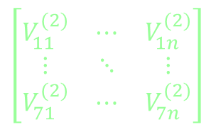
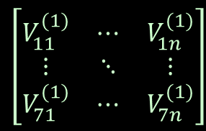
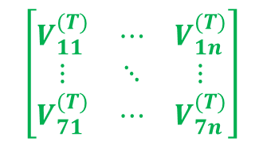
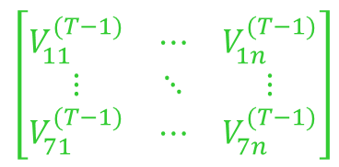
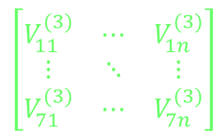
Graph Embedding
60 days ago
59 days ago
58 days ago
…
Yesterday
Today
…
$$\left[\begin{matrix}V_{11}^{(1)} & ⋯ & V_{1n}^{(1)} \\ ⋮ & ⋱ & ⋮ \\ V_{71}^{(1)} & ⋯ & V_{7n}^{(1)}\end{matrix}\right]$$
$$\left[\begin{matrix}V_{11}^{(2)} & ⋯ & V_{1n}^{(2)} \\ ⋮ & ⋱ & ⋮ \\ V_{71}^{(2)} & ⋯ & V_{7n}^{(2)}\end{matrix}\right]$$
$$\left[\begin{matrix}V_{11}^{(3)} & ⋯ & V_{1n}^{(3)} \\ ⋮ & ⋱ & ⋮ \\ V_{71}^{(3)} & ⋯ & V_{7n}^{(3)}\end{matrix}\right]$$
$$\left[\begin{matrix}V_{11}^{(T−1)} & ⋯ & V_{1n}^{(T−1)} \\ ⋮ & ⋱ & ⋮ \\ V_{71}^{(T−1)} & ⋯ & V_{7n}^{(T−1)}\end{matrix}\right]$$
$$\left[\begin{matrix}V_{11}^{(T)} & ⋯ & V_{1n}^{(T)} \\ ⋮ & ⋱ & ⋮ \\ V_{71}^{(T)} & ⋯ & V_{7n}^{(T)}\end{matrix}\right]$$
Methods: Node2Vec, Dynamic Auto-Encoder, Dynamic RNN, Dynamic Auto-Encoder + RNN

Slide 12
Pipeline
SEERA
TWEETS
U1
U1
User | T1 | T2 | T3
U1 | 0.8 | 0.2
U2 | 1
U3 |  | 0.5 | 0.5
U4 |  | 0.8 | 0.2
Topic Modeling
T1:
T2:
U2
User Modeling
U2
U3
T3:
U3
U4
U4
U3
U4
User | D1 | D2 | D3 | D4
U1 | 0.4 | 0.1 | 0.6 | 0.8
U2 | 0.1 | 0.6 | 0.8 | 0.1
U3 | 0.9 | 0.5 | 0.5 | 0.1
U4 | 0.8 | 0.8 | 0.2 | 0.3
Community Prediction
Graph Embedding
U1
U2

Slide 13

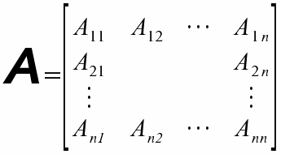
Community Prediction
Louvain graph clustering
T
T + 1

Slide 14
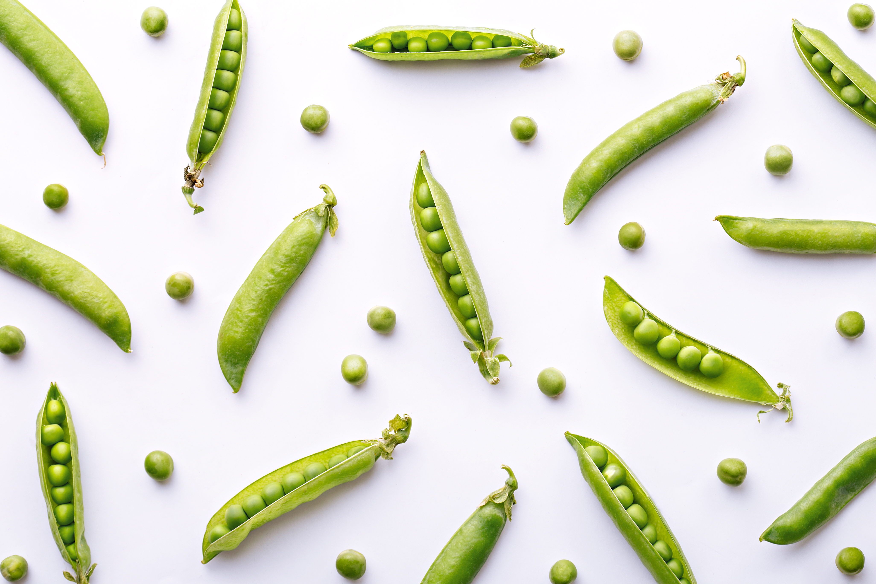

Slide 15
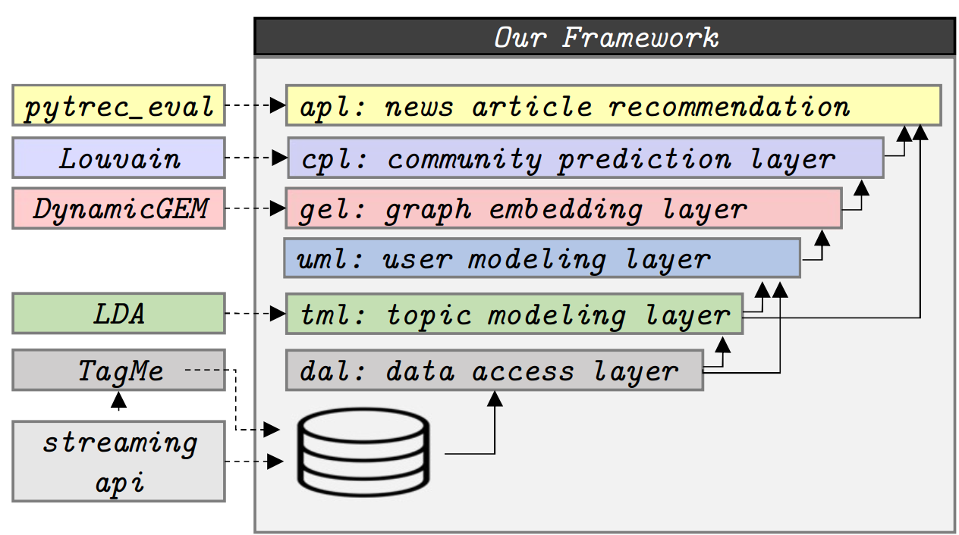
Pipeline
SEERA

Slide 16
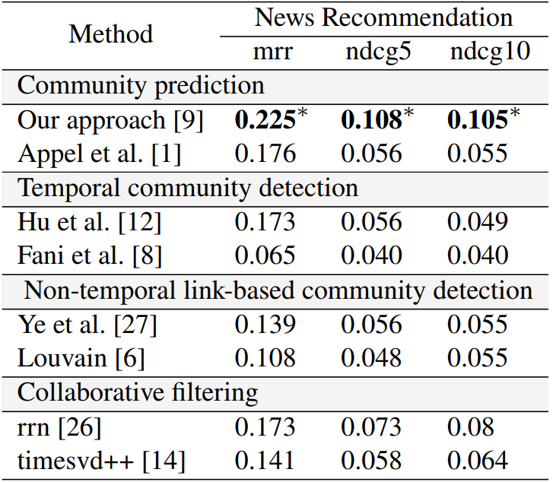
Results

Slide 17
DEMO
https://github.com/fani-lab/SEERa

Slide 18


Contributors:
Soroush Ziaeinejad
Dr. Hossein Fani
Jalal Shabo
Thank you for your attention
Questions

